Slide 1

Content
What is Green Computing
History
Objectives of Green Computing
Implementation
Pathways
Approaches
Recent implementation
Simple tasks we can do
Advantages & disadvantages
Future of Green Computing
Conclusion

Slide 2

What is Green Computing?
Green computing, also known as green IT or sustainable IT, is the environmentally responsible and eco-friendly use of computers and other technology resources.
It involves designing, manufacturing, using, and disposing of computing devices in a way that reduces their environmental impact.
It focuses on reducing energy consumption, minimizing electronic waste, and promoting sustainable practices in the tech industry.

Slide 3
How Computing Harm Environment
Cost of Spam
62 trillion spam messages in 2014
0.3 grams of carbon dioxide (CO2) per message
annual spam energy use 33 terawatt hours (tWh)
equivalent to the electricity used in 2.4 million homes every year
The CO2 dissipated from ‘sleeping’ devices = 1/7th the CO2 emitted by an automobile.

Slide 4
How Computing Harm Environment
Increase in power, cooling and space for data center.
2007-$4.5 billion of electricity
2011-$7.4 billion of electricity
2011-Double CO2 output ( 62 million metric tons)
By electronic appliances.
Desktop requires 85 watts just to idle(Monitor off)
Left on 24 hrs/day-1,500 pounds of CO2 per year.
A tree absorbs between 3 and 15 pounds of CO2 each year.(up to 500 trees)
Hazardous materials inside computers.

Slide 5

History
The term “ Green Computing" was probably coined shortly after the ‘Energy Star’ program began way back in 1992.
One of the first results of green computing was the “ Sleep mode” function of computer monitors.
As the concept developed, green computing began to encompass thin client solutions, energy cost, accounting, virtualization practices, e-Waste, etc.

Slide 6
Objectives of Green Computing
Climate Change :
First and foremost, conclusive research shows that CO2 and other emissions are causing global climate and environmental damage.
Preserving the planet is a valid goal because it aims to preserve life. Planets like ours, that supports life, are very rare.
Savings :
Green computing can lead to serious cost savings overtime. Reductions in energy costs from servers, cooling, and lighting are generating serious savings for many corporations.
maximize energy efficiency during the product’ s lifetime
promote the recyclability or biodegradability of defunct products and factory waste.

Slide 7
Objectives of Green Computing
Reliability of Power :
As energy demands in the world go up, energy supply is declining or flat. Energy efficient systems helps ensure healthy power systems.
Computing :
Computing Power Consumption has Reached a Critical Point. Data centers have run out of usable power and cooling due to high densities.
Materials Recycling :
Parts from outdated systems may be salvaged and recycled through certain retail outlets and municipal or private recycling.
Many organizations, including some manufacturers themselves, are willing to take equipment back and recycle the components into new products.

Slide 8
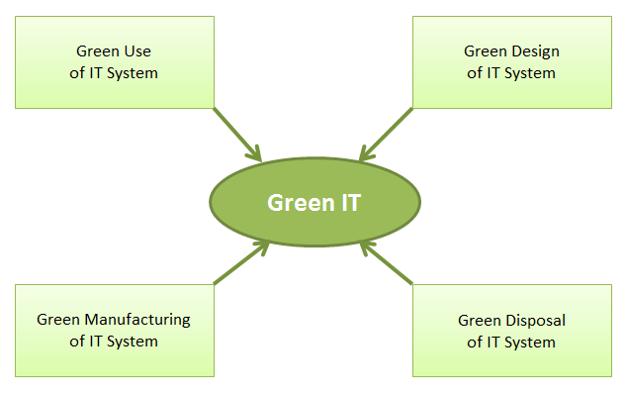
Pathways To Green Computing
Design, manufacture, use and dispose of electronic components, computers, and other associated subsystems with minimal impact on the environment.

Slide 9
Approaches to Green Computing:
Product Longetivity
Software & deployment optimization
Power management
Virtualization
Algorithm Efficiency
Display
Power Supply
Display
Storage
Telecommunicating

Slide 10
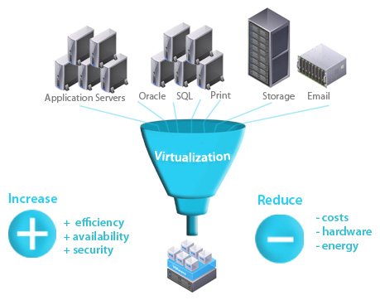
Approaches to Green Computing:
1. Virtualization :
Computer virtualization is the process of running two or more logical computer systems on one set of physical hardware.

Slide 11
Approaches to Green Computing:
2. Power Management :
ACPI allows an operating system to directly control the power saving aspects of its underlying hardware.
Prolong battery life for portable and embedded systems.
Reduce cooling requirements.
Reduce noise.
Reduce operating costs for energy and cooling

Slide 12
Approaches to Green Computing:
3. Video Card :
A fast GPU-largest power consumer
No video card – use a shared terminal or desktop sharing software if display required.
Use motherboard video output – typically low 3D performance and low power.
Reuse an older video card that uses little power, many do not require heat sinks or fans.

Slide 13

Approaches to Green Computing:
4. Telecommuting :
Reduction of greenhouse gas emissions related to travel and increased profit margins.
Increased worker satisfaction.

Slide 14
Approaches to Green Computing
Display:
LCD displays: use a CCF bulb
LED displays: use an array of LEDs
LCD monitors uses 3 times less when active, and 10 times less energy when in sleep mode.
LCDs are up to 66% more energy efficient.
LCDs are also smaller in size and weight.
21" CRT typically uses more than 120W.
Notes:
liquid crystal display

Slide 15
Approaches to Green Computing
Algorithmic efficiency:
The Efficiency of algorithms is used to describe properties of an algorithm relating to how much resources it consumes.
Algorithms are the base of any computing system or electronic device, each and every computer chip has a certain algorithm that allows it to complete its function.
Even though these chips are small, they use a lot of power.

Slide 16
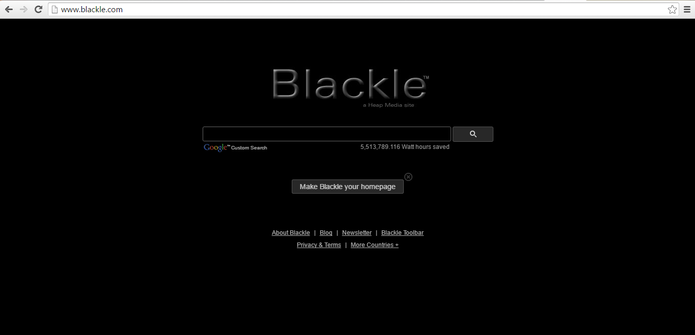
Recent Implementation of Green Computing

Slide 17
Recent Implementation of Green Computing
Zonbu Computer :
Energy efficient PC.
Consumes just 1/3 of the power of a typical light bulb.
The device runs the Linux operating system using a 1.2 GHz processor and 512 MB of RAM.
Fit-PC is designed to fit where a standard PC is too bulky, noisy and power hungry .
Fit-PC draws only 5 Watts, consuming in a day
less power than a traditional PC consumes in 1 hour.

Slide 18
Recent Implementation of Green Computing
Sun Ray thin Client :
Thin clients like the Sun Ray consume far less electricity than conventional desktops.
A Sun Ray on a desktop consumes 4 to 8 watts of power, because most of the heavy computation is performed by a server.
Suited for cost-sensitive environments such as call centers, education, healthcare, service providers and finance.

Slide 19

Steps by Apple
MacBook keyboards are made from one single piece of aluminum
MacBook pro notebooks have long lasting batteries where as a normal notebook uses three batteries
A MacBook will only use one through out its life time.

Slide 20

Steps by DELL
Their free world-wide product recycling program allows user to properly dispose their product safely.
Their “Plant a tree for me” project can offset a customers carbon emissions for only three dollars.

Slide 21
Simple Tasks we can do..
Turn your computer and monitor off when you are not using it.
Enable hibernation using the power management settings. Standby does not save as much power.
Use Linux (such as Ubuntu), which requires less resources than many other operating systems.

Slide 22
Advantages
Energy saving
Environmentally Friendly
Cost-effective ( pays over time )
Save more money per year
Can give you a tax right off

Slide 23
Disadvantages:
High start up cost
Not readily available
Still in experimental stages
Sacrifieses performance for battery life
Not for everyone

Slide 24
Future of Green Computing :
The plan towards green IT should include new electronic products and services with optimum efficiency and all possible options towards energy savings.
That is enterprise wise companies are laying emphasis on moving towards Eco Friendly Components in Computers, the use of eco-friendly sustainable components will become the norm rather than the exception in future.

Slide 25
Conclusion
Green computing promotes the sustainable use of technology while reducing environmental impact.
Energy-efficient practices, sustainable manufacturing, and proper e-waste management are critical components.
Virtualization and cloud computing play a significant role in minimizing resource consumption.

Slide 26
References
https://en.wikipedia.org/wiki/Green_computing
https://www.ibm.com/think/topics/green-computing
https://www.energystar.gov/
https://www.grafiati.com/en/literature-selections/green-computing/
https://www.researchgate.net/publication/275833692_Green_Computing_and_Sustainable_Environment_-_Introduction_of_E-documents_and_Replacement_of_Printed_Stationeries

